Slide 1

Difficult Airway Society 2025 guidelines for management of unanticipated difficult tracheal intubation in adults
Summary slide deck

Slide 2
This slide deck is intended to be used to support local educators in delivering the 2025 DAS Intubation Guidelines locally. Adaptation of the contents of this presentation for local needs is acceptable but is not the responsibility of the authors. Any copyright to content should adhere to CC BY-NC-ND licenses. For permissions, please contact DAS.

Slide 3
BACKGROUND
Evolving clinic practice and evidence since 2015 guidelines
More complex patients requiring airway management
More understanding of newer airway techniques
More understanding of risks
Better understanding of newer equipment
Peroxygenation

Slide 4
AIMS
Maximise chances of success
Improve safety and efficacy
Prioritise oxygenation, capnography and neuromuscular blockade throughout Plans A–D
Encourage timely progression through plans
Minimise decision making at crucial points

Slide 5
DISCLAIMER
Do not represent a minimum standard of practice
Are not a substitute for good clinical judgement
Do not account for all possible clinical scenarios
Provide a framework for decision making

Slide 6
AIRWAY ASSESSMENT
Airway assessment should be performed before induction of anaesthesia.
Assessment should include history, examination with bedside tests and when appropriate, review of relevant investigations. The physiologically difficult airway should also be considered.

Slide 7
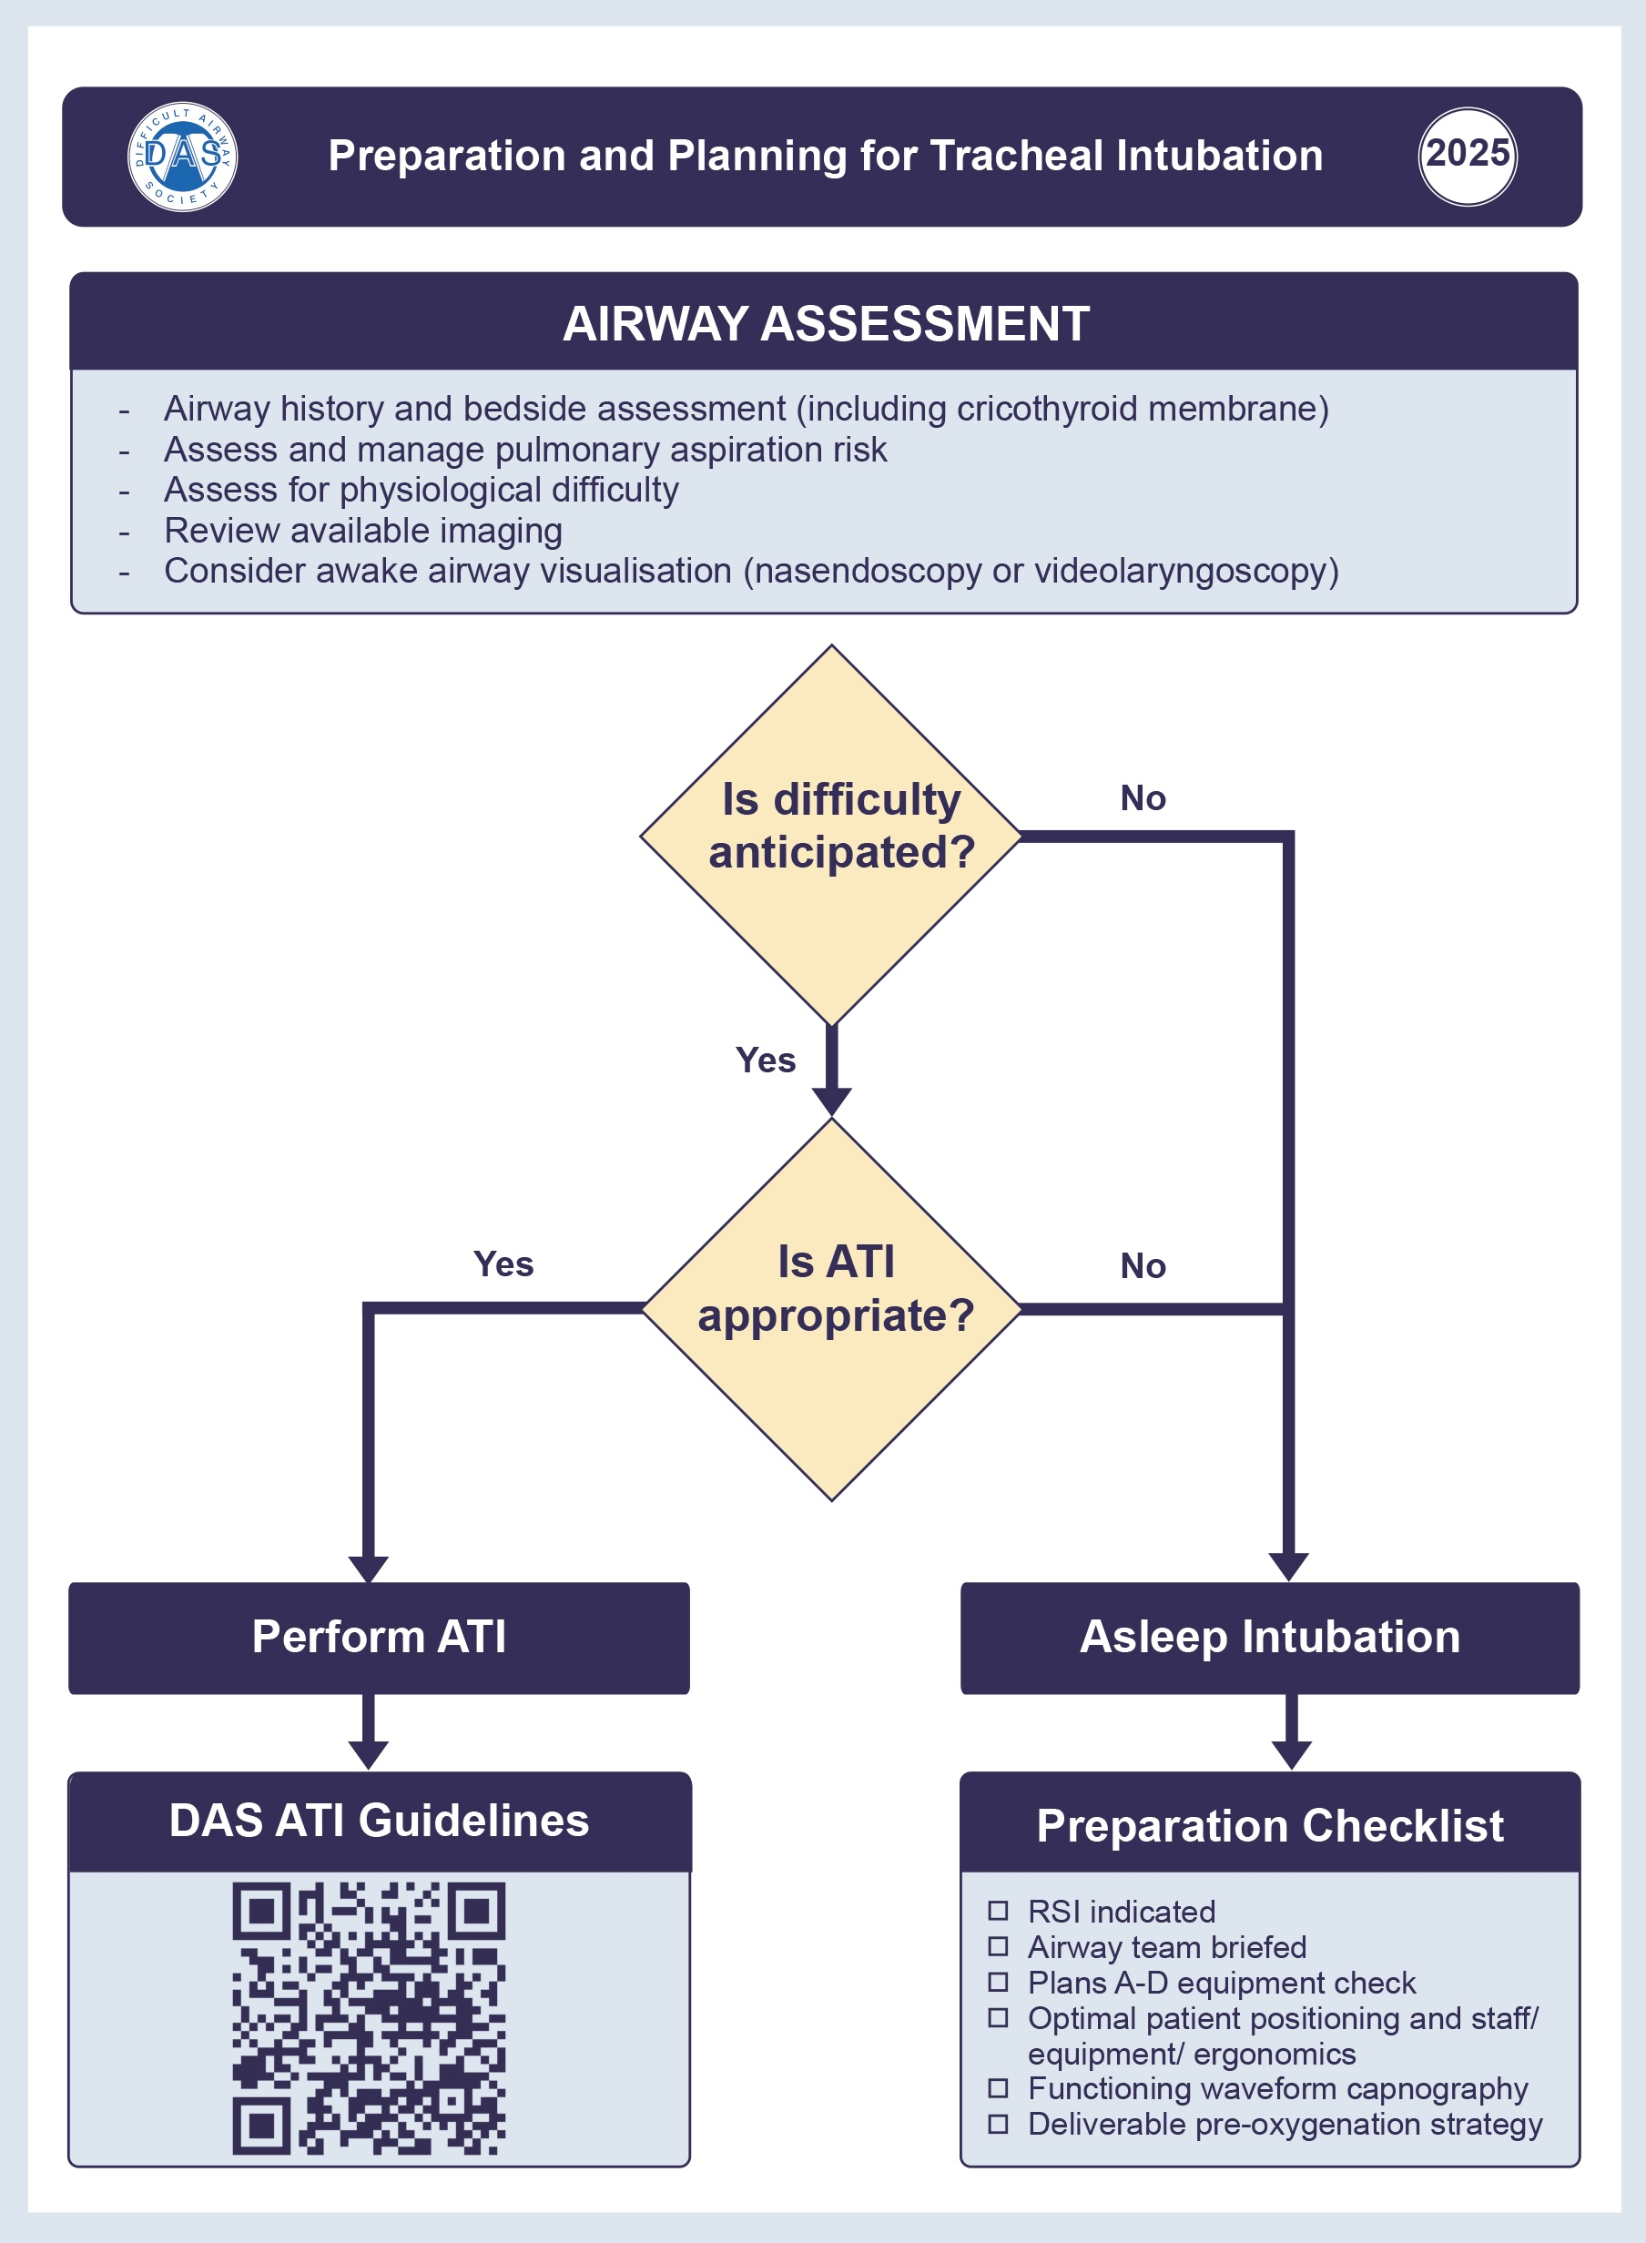

Slide 8
PLANNING AND STRATEGY
The airway management strategy should address any anticipated difficulty in A) tracheal intubation; B) SAD insertion or ventilation; C) facemask ventilation; and D) eFONA.
The airway management strategy should be guided by any history of previous difficulty.
If any difficulty is anticipated in Plans A, B, C or D, ATI should be considered.

Slide 9
PLANNING AND STRATEGY
The airway management strategy should be clearly communicated with the anaesthetic assistant.
Airway management should be discussed as part of the theatre team briefing.
Patient position should be optimised before pre-oxygenation and for tracheal intubation.
Equipment for delivering Plans A–D must be immediately available in all areas where airway management is performed.

Slide 10
PLANNING AND STRATEGY
Out-of-hours airway management is associated with increased risks; teams should plan accordingly.
Optimal location for airway management should be considered.
Consider a checklist when performing emergency tracheal intubation.

Slide 12
MONITORING
Waveform capnography should be checked before induction of anaesthesia.
Audible SpO₂ tones should be enabled before induction of anaesthesia.
Continuous, uninterrupted waveform capnography should be used throughout all phases of airway management.

Slide 13
MONITORING
Quantitative neuromuscular monitoring should be used to confirm adequate neuromuscular blockade before tracheal intubation attempts, when feasible.
Institutions should provide equipment that enables patient monitoring in accordance with current Association of Anaesthetists recommendations.

Slide 14
DRUGS
Neuromuscular blocking agents should be routinely used to facilitate tracheal intubation.

Slide 15
PEROXYGENATION
The process of continuous oxygen delivery from before induction of anaesthesia (pre-oxygenation), during apnoea (apnoeic oxygenation), and throughout attempts at airway management (e.g. laryngoscopy) until the airway is secured.

Slide 16
PEROXYGENATION
All patients should be pre-oxygenated before induction of general anaesthesia.
Pre-oxygenation should be performed in the head-up position and with a technique allowing positive pressure, where feasible.
In patients with a risk of difficult airway management, peroxygenation should be used, ideally with high-flow nasal oxygen.

Slide 17
DAS 2025 DIFFICULT UNANTICIPATED TRACHEAL INTUBATION ALGORITHM

Slide 18
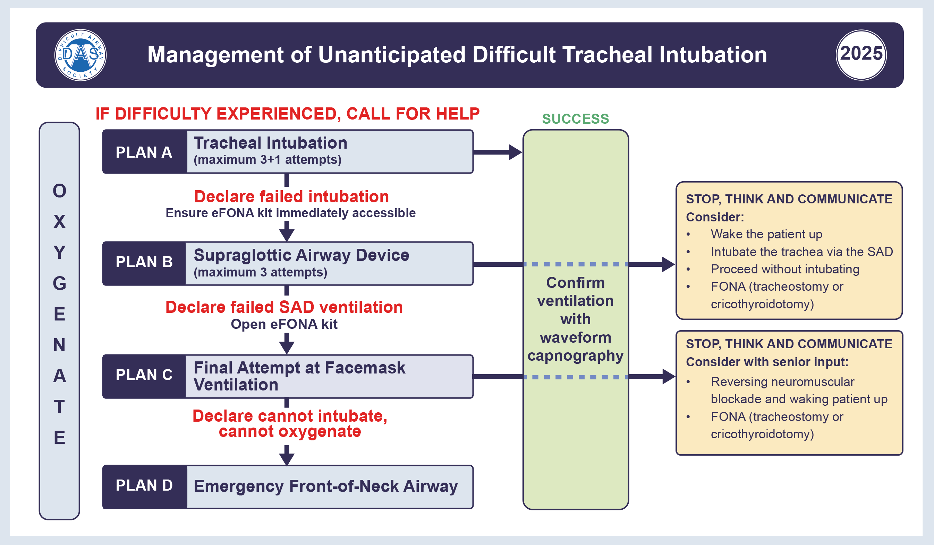

Slide 19
PLAN A:
TRACHEAL INTUBATION

Slide 20
PLAN A: TRACHEAL INTUBATION
A videolaryngoscope should be used for tracheal intubation whenever possible.
Airway managers should be aware of the differences in videolaryngoscope blade types and techniques.
Airway managers should attain and maintain competence in the use of videolaryngoscopes available in their department.

Slide 21
PLAN A: TRACHEAL INTUBATION
The number of intubation attempts should be limited to a maximum of three, plus one final attempt by a more experienced colleague (3+1).
A stylet, bougie or flexible bronchoscope should be used with a hyperangulated videolaryngoscope blade.
Successful tracheal intubation ideally should be confirmed with a two-point check: sustained exhaled carbon dioxide and visualisation of the tracheal tube through the vocal cords.

Slide 22
PLAN A: TRACHEAL INTUBATION
In the event of a poor glottic view during laryngoscopy, consider use of external laryngeal manipulation.
When difficulty with laryngoscopy or tracheal intubation occur:
  Continue oxygenation throughout
  Maintain anaesthesia
  Optimise head and neck position; blade size and type; adjunct; tube size and type; external laryngeal manipulation; remove cricoid force; optimise neuromuscular blockade; change operator; suction; and optimise ergonomics

Slide 23
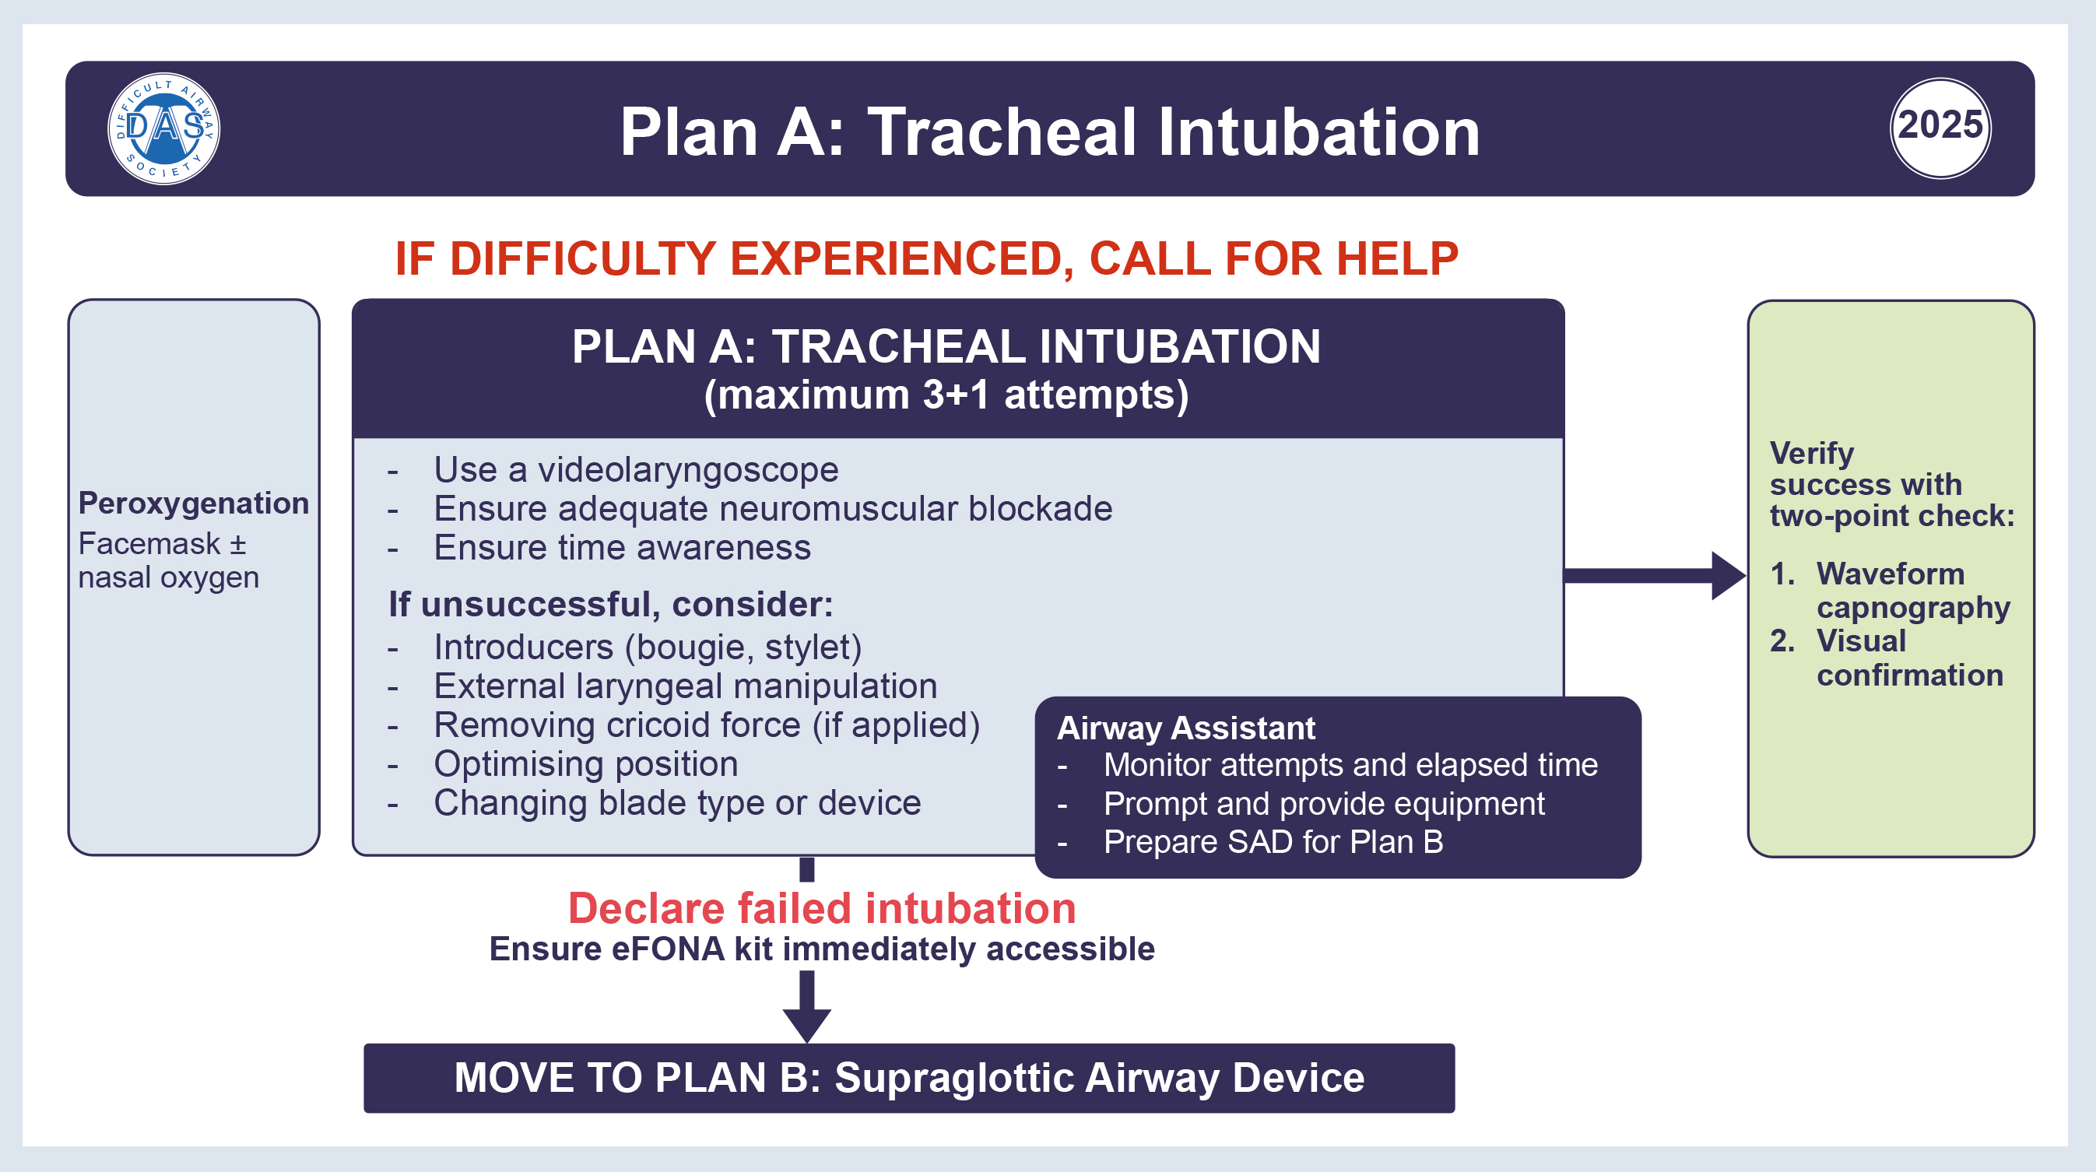

Slide 24
PLAN A: TRACHEAL INTUBATION
Facemask ventilation
Do not delay administration of neuromuscular blockade to check facemask ventilation.
Facemask ventilation should be used to maintain oxygenation between attempts at airway instrumentation.

Slide 25
PLAN A: TRACHEAL INTUBATION
Facemask ventilation
Airway manoeuvres and/or adjuncts may be used to improve ease of facemask ventilation where required.
When facemask ventilation is difficult this should be verbalised to the team, help should be sought immediately and the airway strategy adjusted appropriately.

Slide 26
PLAN A: TRACHEAL INTUBATION
Facemask ventilation

Slide 27
PLAN B:
SUPRAGLOTTIC AIRWAY DEVICE (SAD)

Slide 28
PLAN B: SAD
Airway managers should attain and maintain competence in the use of second-generation SADs available in their department.
If tracheal intubation fails (Plan A), a second-generation SAD should be used to attempt rescue.

Slide 29
PLAN B: SAD
The number of SAD insertion attempts should be limited to a maximum of three.
Once effective oxygenation is established with a SAD, stop, think and communicate.

Slide 30
PLAN B: SAD
If proceeding is not essential, wake the patient up.
If proceeding is essential and ventilation through the SAD is satisfactory, consider continuing with the supraglottic airway device.
If tracheal intubation is essential, consider one attempt at intubation through the SAD using a flexible bronchoscope or perform a FONA (tracheostomy or cricothyroidotomy).

Slide 31
PLAN B: SAD
Blind tracheal intubation through a SAD is not recommended.
If SAD ventilation is difficult, start priming for eFONA.

Slide 32
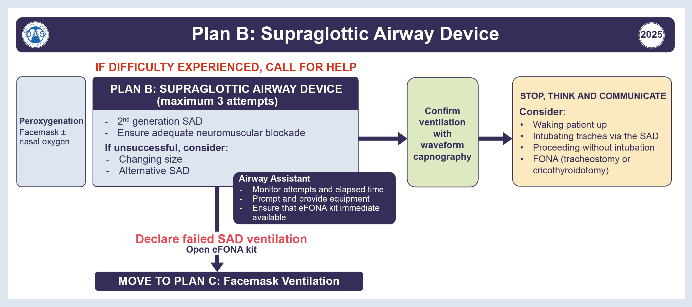

Slide 33
PLAN C:
FINAL ATTEMPT AT FACEMASK VENTILATION

Slide 34
PLAN C: FINAL ATTEMPT AT FACEMASK VENTILATION
When tracheal intubation and ventilation through a SAD have failed, a final attempt at oxygenation by facemask ventilation should be made.
For this final rescue attempt at facemask ventilation:
  Ensure adequate neuromuscular blockade
  Ensure patient positioning is optimised
  Use airway adjuncts
  Use a four handed (two-person) technique
  Ensure adequate depth of anaesthesia

Slide 35
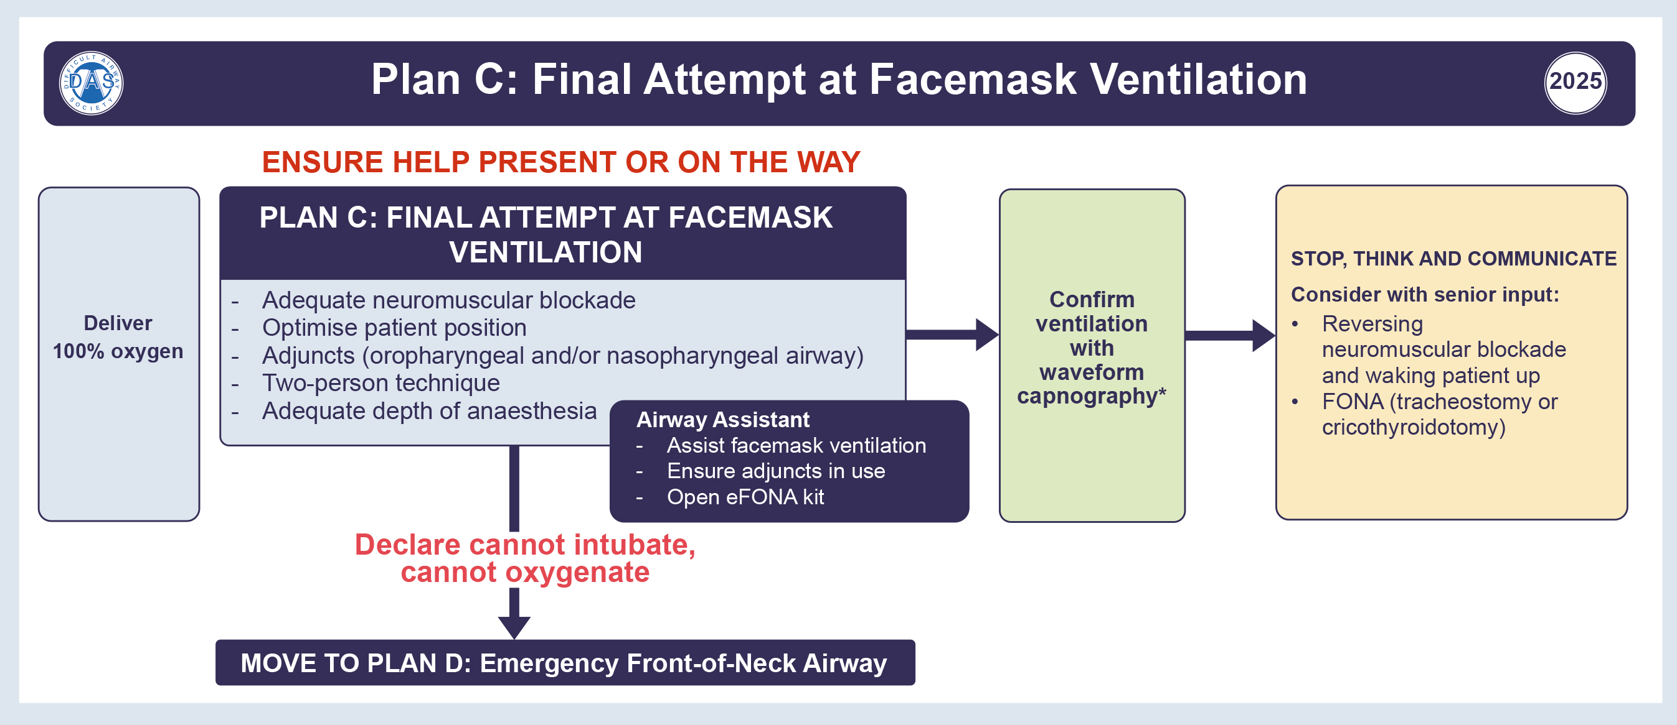

Slide 36
PLAN D:
EMERGENCY FRONT-OF-NECK AIRWAY (eFONA)

Slide 37
PLAN D: eFONA
Where Plans A, B and C have failed, and a cannot intubate, cannot oxygenate scenario exists, an eFONA (Plan D) must be performed.
Ensure maximal neck extension before performing an eFONA, where feasible.
Give a full dose of neuromuscular blocking drug before performing an eFONA.
Psychological support should be available to those who have been involved in an eFONA scenario.

Slide 38
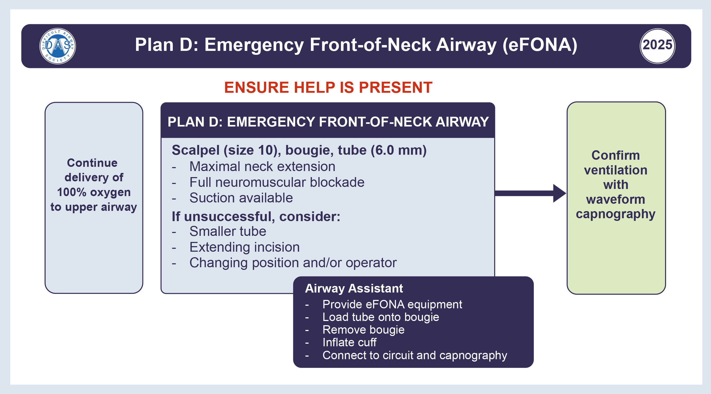

Slide 47
RAPID SEQUENCE INDUCTION AND INTUBATION (RSI)
If cricoid force is used and the view at laryngoscopy is poor, it should be removed in an attempt to improve the view.
Assistants providing cricoid force should receive regular training in correct application.

Slide 49
PHYSIOLOGICALLY DIFFICULT AIRWAY
Physiological (e.g. old age, pregnancy) and pathophysiological (e.g. sepsis, cardiac failure) alterations including hypoxaemia, haemodynamic instability and complications on transition to positive pressure ventilation

Slide 50
OBESITY
Consider ATI in people living with obesity.
Patients should be pre-oxygenated in a head-up position (≥30º).
Consider performing airway management in the operating theatre.
Consider use of high-flow nasal oxygen for peroxygenation.
Consider early use of second-generation SADs for ventilation if facemask ventilation is suboptimal.

Slide 51
DOCUMENTATION
Individuals have a professional responsibility to document airway management as provided by their institution.

Slide 52
EDUCATION, TRAINING AND INSTITUTIONAL RESPONSIBILITY
Institutions should support and facilitate individuals at all levels to train and maintain competencies in airway management with clinical and non-clinical multidisciplinary training.
Institutions should support clinicians to train with new equipment or guidelines.
Airway Leads should reinforce familiarity with the Plan A–D approach amongst airway managers and assistants.

Slide 53
EDUCATION, TRAINING AND INSTITUTIONAL RESPONSIBILITY
Human factors and team performance under stress should be included in training.
All individuals involved in airway management should have training in capnography interpretation.
All airway managers should be regularly trained in performing an eFONA.

Slide 54


RESOURCES
2025 DAS Guidelines
2025 DAS Educational Package

Slide 55
AUTHORS
Imran Ahmad, Kariem El-Boghdadly, Helen Iliff, Gunjeet Dua, Andy Higgs, Mike Huntington, Fauzia Mir, S. A. Reza Nouraei, Ellen P. O’Sullivan, Anil Patel, Kate Rivett, Alistair F. McNarry

